Slide 1
Enhancing Personalized Learning of Students through Deep Learning in an Adaptive Learning Environment.
M.P. Madushan Pathirana | 208880243
Supervisor – Dr.L.N.C.De Silva

Slide 2
Introduction
E-learning
E-learning Personalized teaching and learning frameworks immerged to fill the gaps in teacher centered educations system
E-learning systems | Characteristics
Learning Management Systems | LMS delivers content and help administrative tasks
Adaptive Hypermedia Systems | Provide content based on user goal and performance
Learning Style Based Adaptive Educational Systems | Personalize the learning experience based on learning style (visual, auditory, reading/writing, and kinesthetic)
Intelligent Tutoring Systems | Provide immediate and customized instruction/feedback without human intervention using Adaptive Learning

Slide 3
Introduction
Adaptive learning
Adaptative learning is a range of tools and techniques to personalize the learning experience for students
As an example for the same learning objectives two students get different number of question and instruction depend on the knowledge level
It provides valuable insights to teachers and administrators
There are three main components in an adaptive learning system
Learner model
Adaption model
Domain model

Slide 4
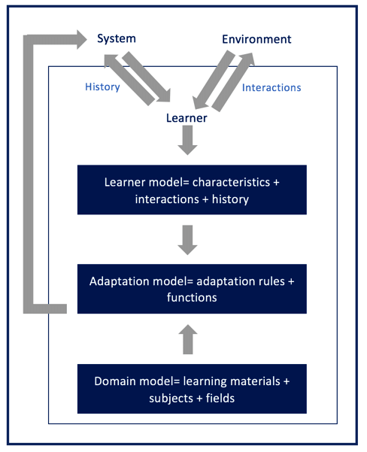
Learner model collects data
adaptation model adjusts the learning experience through knowledge tracing
Represents the knowledge being taught in adaptive learning
Figure 1‑1 Adaptive e-learning systems' components (Ennouamani and Mahani, 2018)

Slide 5
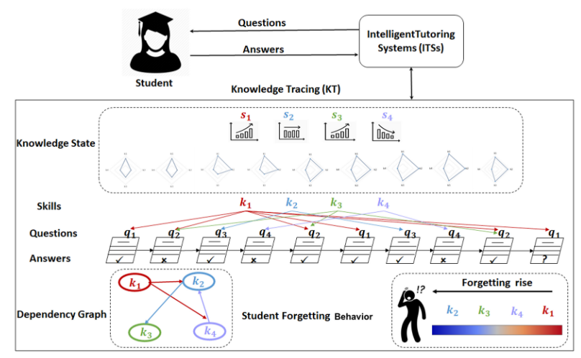
Knowledge Tracing
Knowledge Tracing is a machine learning technique that models a student's mastery of concepts over time.
There are two branches of knowledge tracing. They are
Traditional knowledge tracing - Statistical techniques
Deep knowledge tracing – Deep learning-based techniques

Slide 6
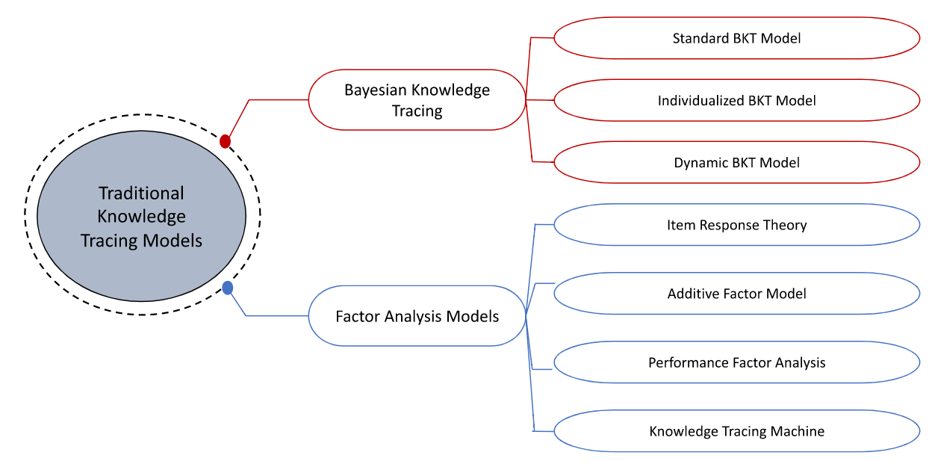
Traditional Knowledge Tracing

Slide 7
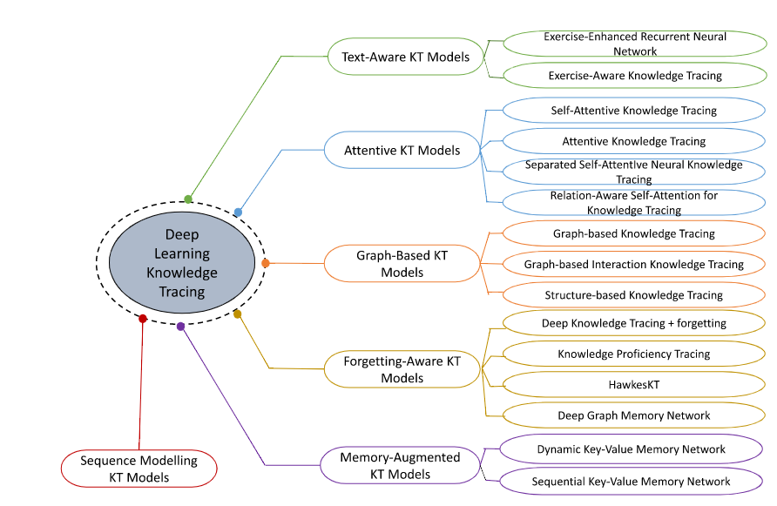
Deep Knowledge Tracing

Slide 8
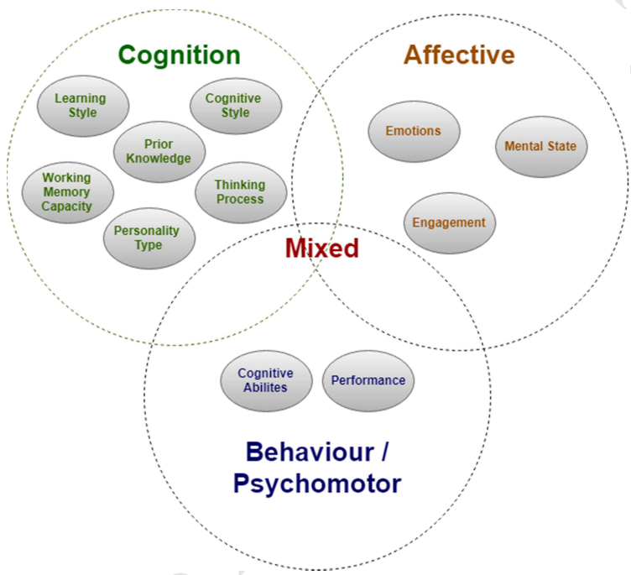
Learner Characteristics
Learner characteristics are the main inputs of knowledge tracing methods.
Based on the collected data set this study focus on Performance and Prior Knowledge . They can measure through
Mastery and correctness of answers
Previous grades
Rank
Previous experience with the course content
Prior credits
course repetition.
(Afini Normadhi et al., 2019)

Slide 9
Literature Review
Domain | Research topic | Approach and findings
Adaptive learning | Adaptive learning: Helpful to the flipped classroom in the online environment of COVID? (Clark, R.M., Kaw, A.K. and Braga Gomes, R., ) 2022 | Conducting a comprehensive survey on knowledge tracing by categorizing methods, identifying datasets and their performance, exploring possible application areas, and discussing future research directions
Adaptive learning | An overview of adaptive e-learning systems (Ennouamani, S. and Mahani, Z) 2018 | Literature review on adaptive learning systems
Adaptive learning /Recommendation | Towards an adaptive learning framework for MOOCs (Ardchir S,Talhaoui M,Azzouazi M) 2017 | Developed a personalized learning pathway recommendation system for Massive Open Online Courses based on user competency.
Deep Knowledge Tracing | Deep Knowledge Tracing (Piech, C., Bassen, J., Huang, J., Ganguli, S., Sahami, M., Guibas, L., Sohl-Dickstein, J) 2015 | Introduced deep knowledge tracing using deep learning for the first time. Overperformed traditional methods

Slide 10
Literature Review
Domain | Research topic | Approach and findings
Deep Knowledge tracing | Structure-based knowledge tracing: An influence propagation view (Tong, S., Liu, Q., Huang, W., Huang, Z., Chen, E., Liu, C., Ma, H. and Wang, S) 2020 | Add temporal and special dimensions to deep knowledge tracing. Measured knowledge statues of multiple learning objectives at once
Knowledge Tracing | A Survey. ACM Computing Surveys(Abdelrahman, G., Wang, Q. and Nunes, B). 2023. | The work provides a survey on knowledge tracing, including methods, datasets, applications, and future research directions, summarizing 134 studies
Learner Characteristics | LEARNER CHARACTERISTIC BASED LEARNING EFFORT CURVE MODE: THE CORE MECHANISM ON DEVELOPING PERSONALIZED ADAPTIVE E-LEARNING PLATFORM. (Hsu, P) 2012 | Model and identified 16 learning curve types. These curved can use to identify support need students and degree of support
Learner Characteristics | Clustering children's learning behaviour to identify self-regulated learning support needs (S.H.E. Dijkstraa, M. Hinneb, E. Segersa, I. Molenaar) 2023 | Model and identified 9 learning curve types using statistical methods. Assessed how learning curve changed after studying

Slide 11
Domain | Research topic | Approach and findings
Recommendation System | Recommending Learning Objects Based on Utility and Learning Style (Borges, G. and Stiubiener, I) 2014 | Recommend suitable learning objectives based students learning style and performance
Recommendation System | Personalized Links Recommendation Based on Data Mining in Adaptive Educational Hypermedia Systems (Duval, E., Klamma, R. and Wolpers, M., ) 2007 | Recommend study materials based on pervious web site usage. Do not consider stundets performance is a weakness
Recommendation System | Using Simulations to Evaluate the Effects of Recommender Systems for Learners in Informal Learning Networks ( Hendrik Drachsler, Hans Hummel and Rob Koper) | The work includes a model and flow chart of the simulation, outlines the collaborative filtering techniques to be investigated, and presents the experimental design for testing recommender systems in informal learning networks.

Slide 12
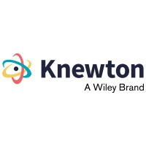
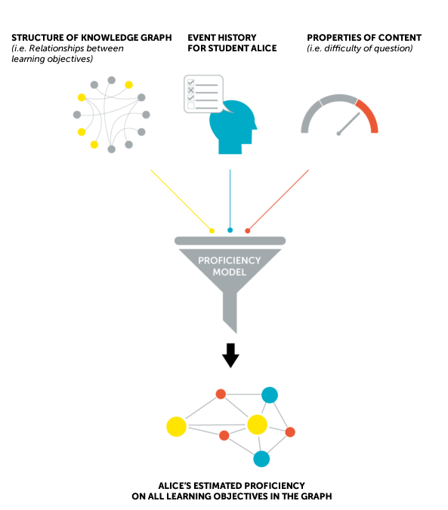
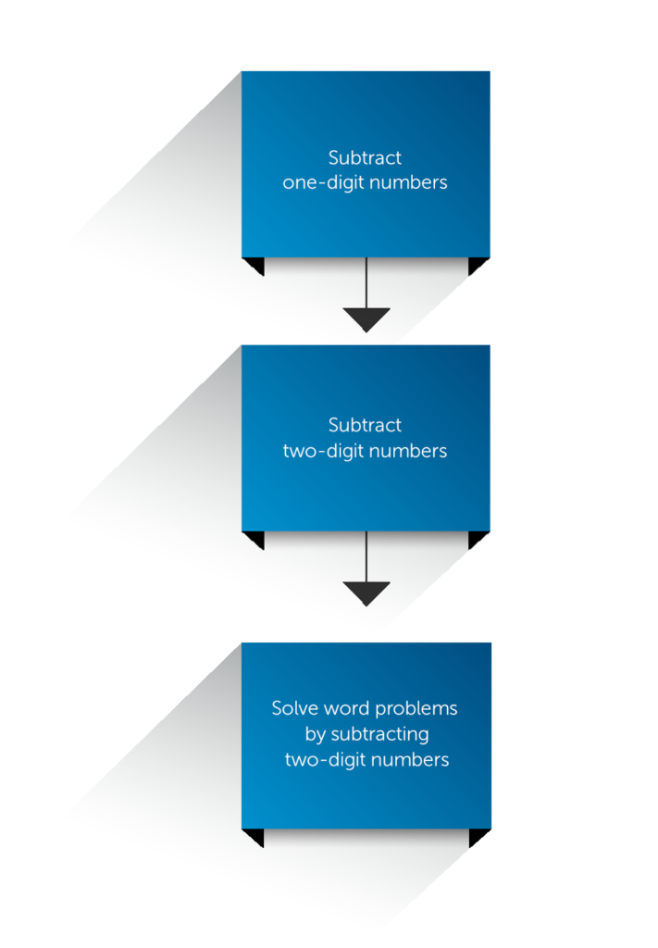
Introduction to the Studying Adaptive Learning System
Sample knowledge graph
Knewton is an adaptive learning company
It provide personalized educational content
They use modified version of Item Response theory

Slide 13
Introduction to the Studying Adaptive Learning System
Set Goal (assignments)
Goals are homework set by the instructor related to set of learning objectives
Assess students' knowledge state
After each question, based on the correctness of the answer, student's knowledge state is estimated using a statistical method
Recommend next activity
Based on the knowledge statues recommend next item to the user ( difficult or easy item / study material)

Slide 14
Research gap
Despite the vast literature on knowledge tracing, there is a need for further exploration on the application of different methods in educational settings.
Previous studies clustered students learning curve based on score but not based on the mastery level
Previous studies haven’t compare learning curve clusters with other characteristics such as time spend for a question, time spent on instructions and quality of the study materials
Under deep knowledge tracing, no study have assessed the impact of presenting study materials middle of the question sequence

Slide 15
Research Questions
What are the factors impact students personalized learning in an adaptive learning environment?
What is the impact of learning materials on students personalized learning in an adaptive learning environment ?

Slide 16
Research Objectives
Identify the factors that influence personalized learning in an adaptive learning environment
Evaluate the effectiveness of study material recommendations in improving student learning outcomes.
Predict students’ mastery using Deep Learning when study materials presented middle of the question sequence
Explore the use of machine learning algorithms for study material recommendation in an adaptive learning environment.

Slide 17
Research Methodology - Data
Data collection – Required data is already collected and further
Data is from a commercial adaptive learning system
Data contains students' performance under ‘Applied Mathematics’ curriculum and related knowledge graphs

Slide 18
Data
Data Set | Number of Data Points | Attributes
Student coursework performance | 3.3 million | Learning objectives question id and study material id Answer correctness and mastery level time spent to answering and instructions
Student assignment | 140,000 | Learning objectives test id user id question id correctness of the answer
Learning objective map (knowledge graph) | 1145 | Source LO Id (prerequisite LO ID) Destination LO Id Source LO Title (prerequisite LO Name) Destination LO Title

Slide 19
Research Methodology
Data processing
Handle null values
Pivot student mastery to learning curves
Develop knowledge graphs (networks) from tabular data
Algorithms
Clustering algorithms
Deep learning
Recommendation algorithm
Evaluation
Evaluate mastery prediction based on correctness of answers

Slide 20
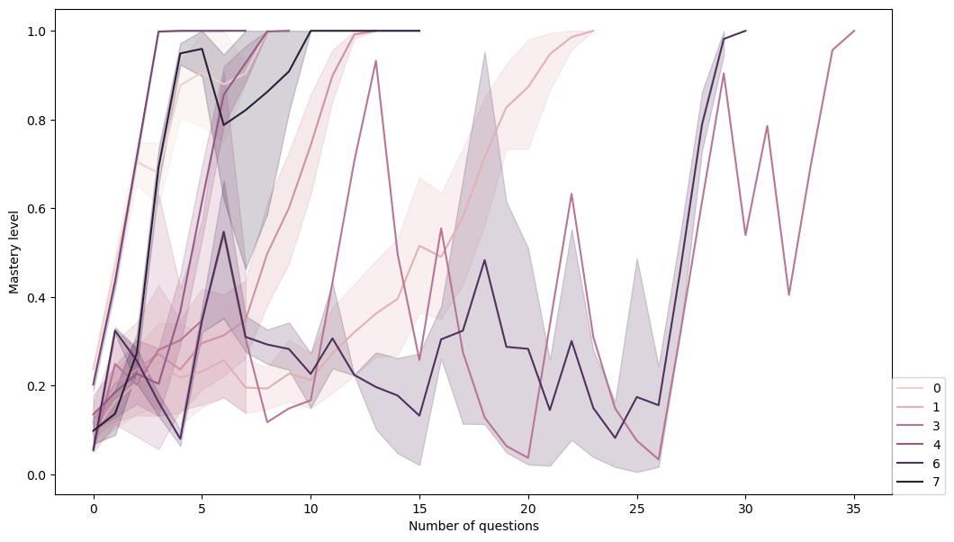
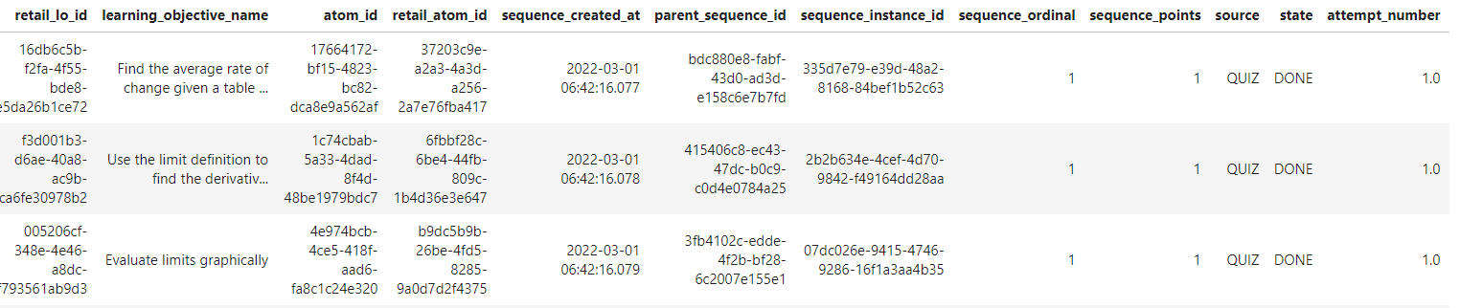
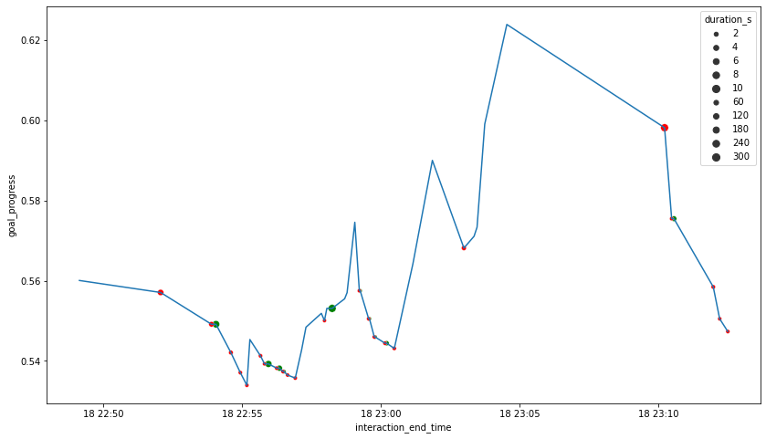
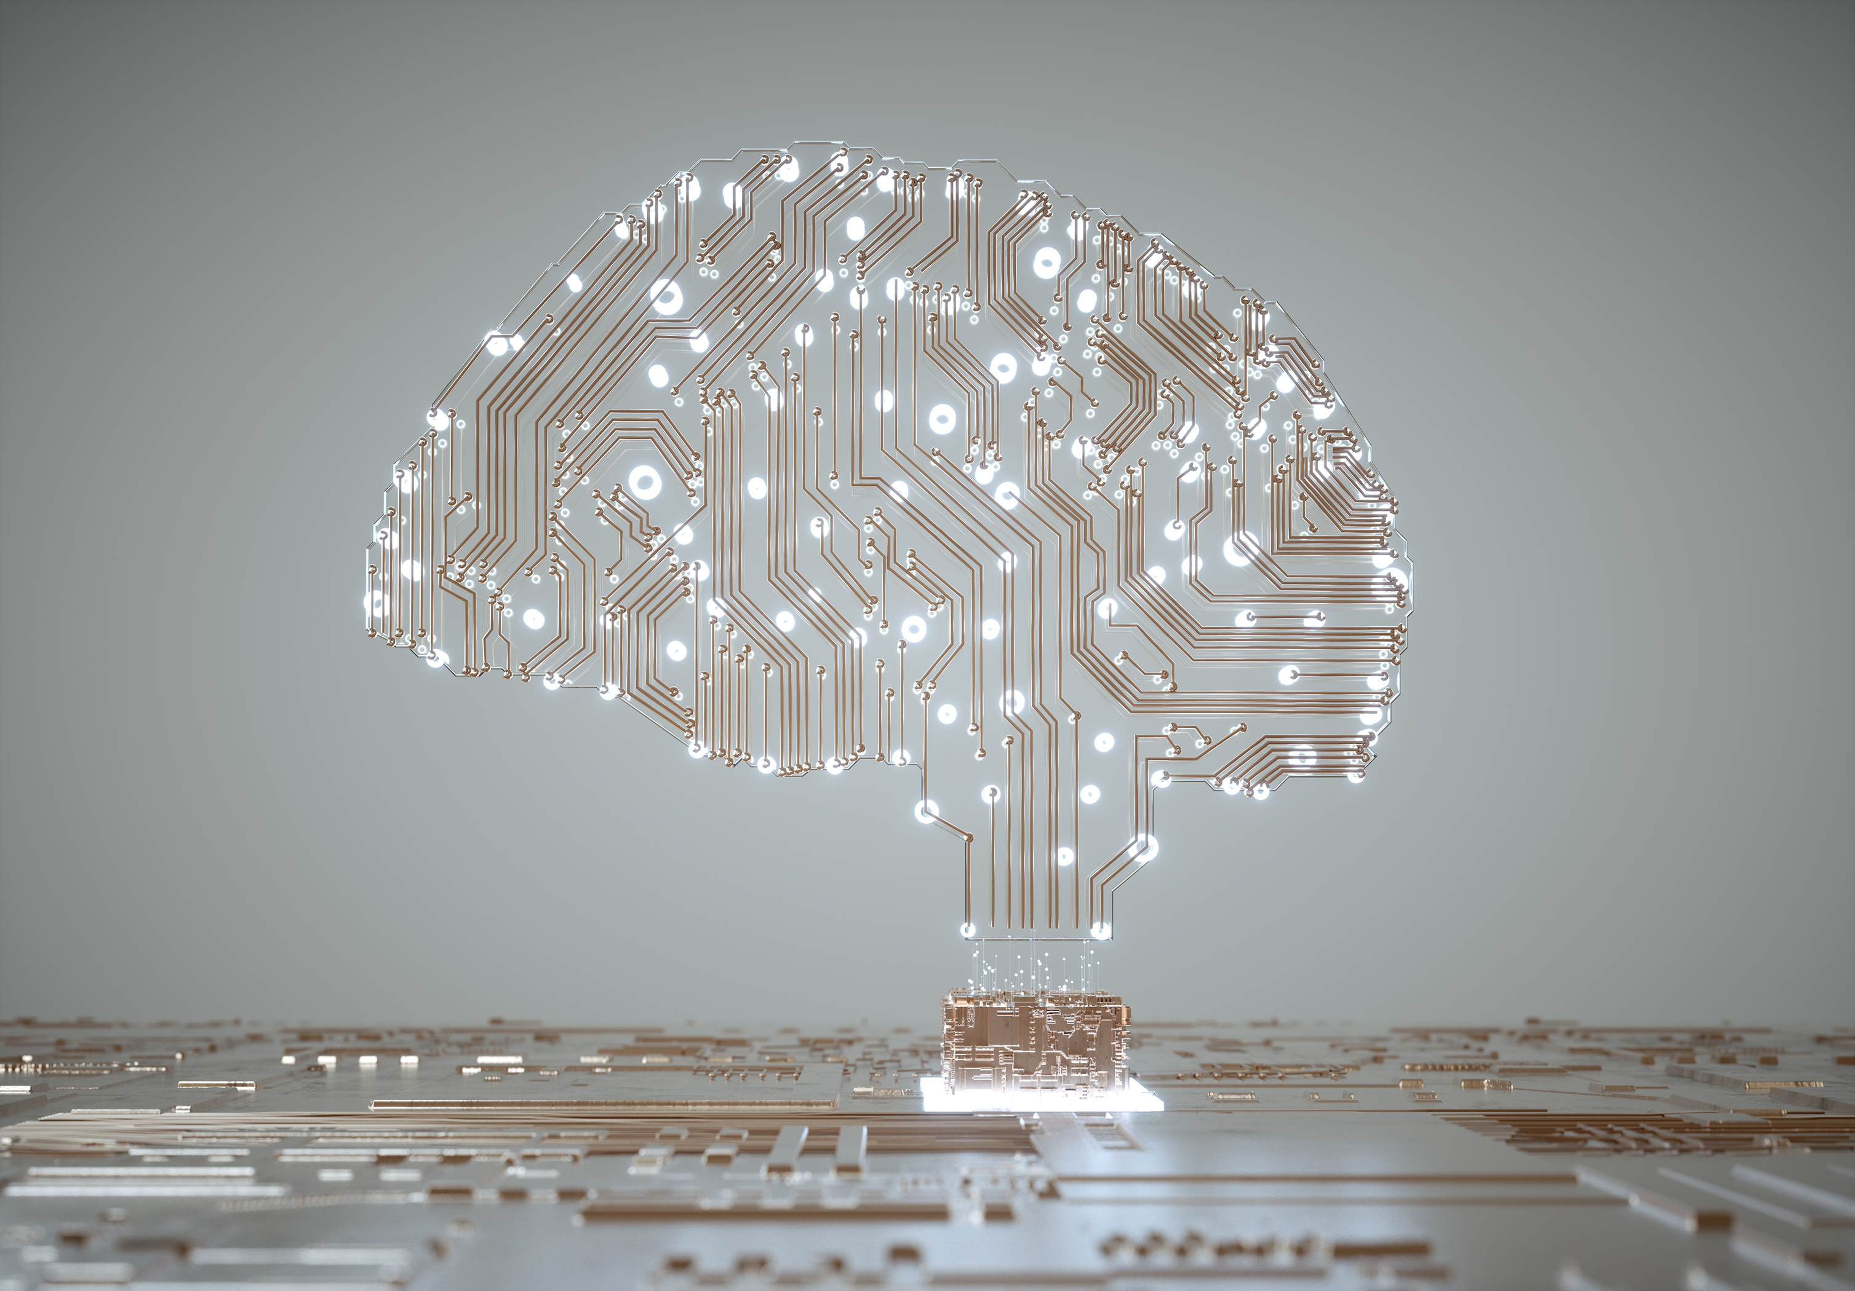
Research Methodology (summary)
Data
(Student performance)
Develop students learning curves
Cluster learning curves
Compare and contrast clusters
Predict student mastery using deep learning
Recommend items based on student mastery level
Data
(Knowledge graph)

Slide 21
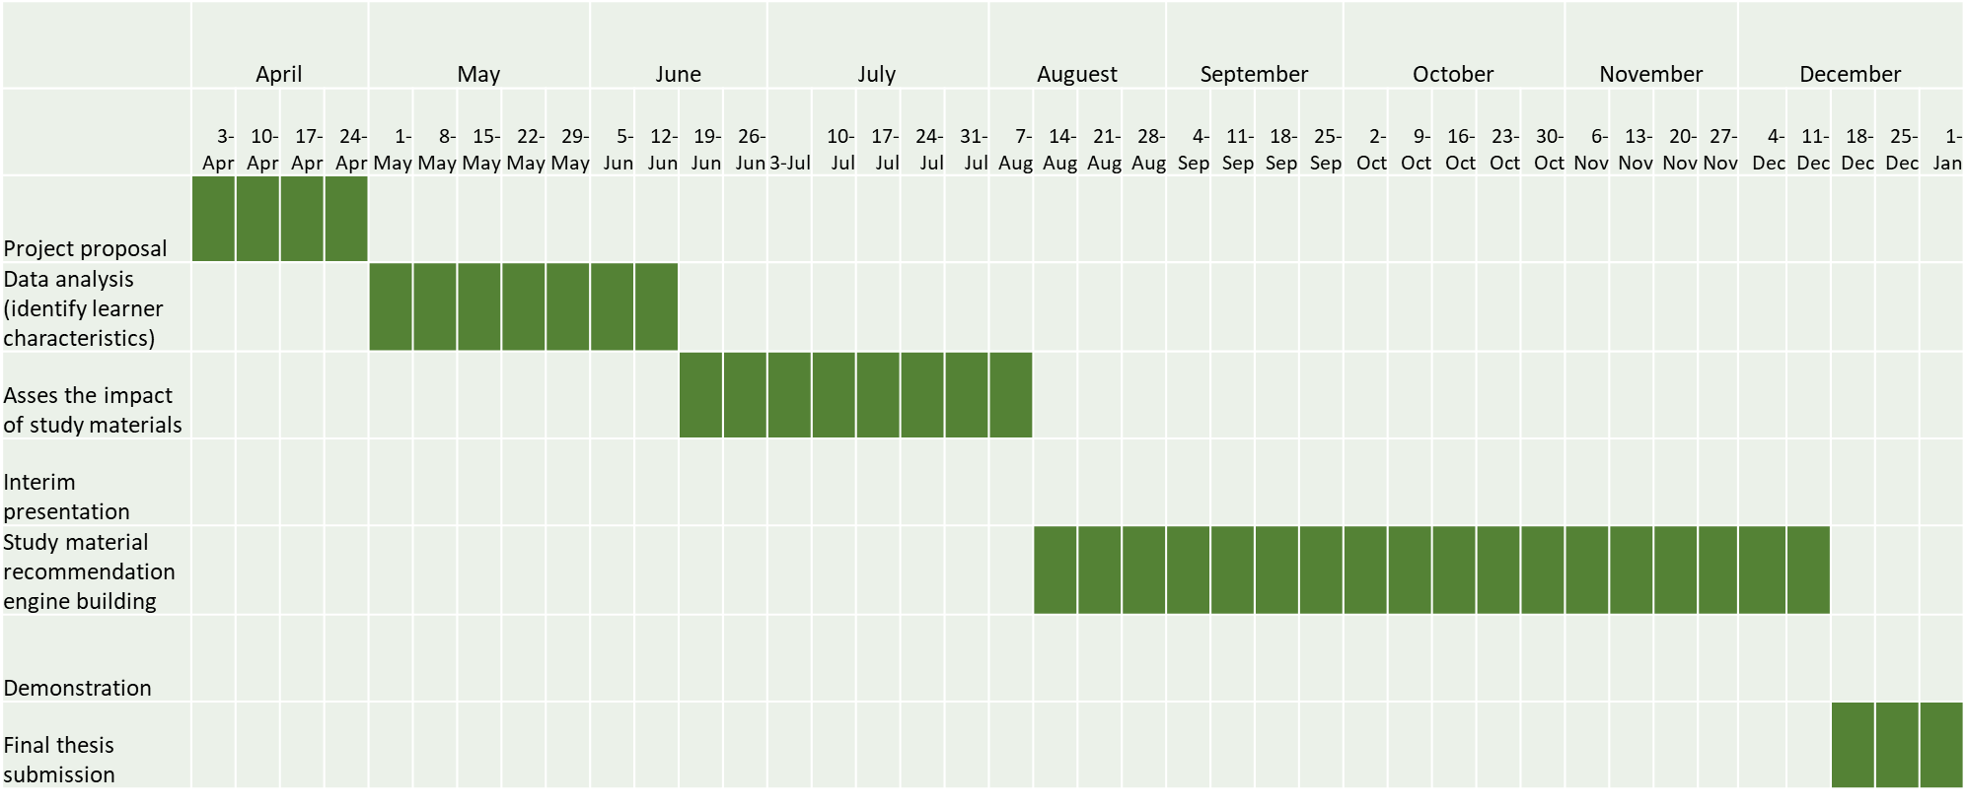
Timeline

Slide 22
Thank You
Q & A

Slide 23
Appendix - Sample Learning Curve
Questions
Instructional materials

Slide 24
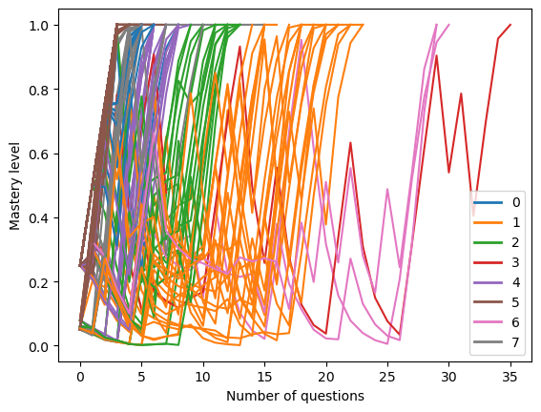
Appendix - Clustering Learning Curves (ability cure)

Slide 25
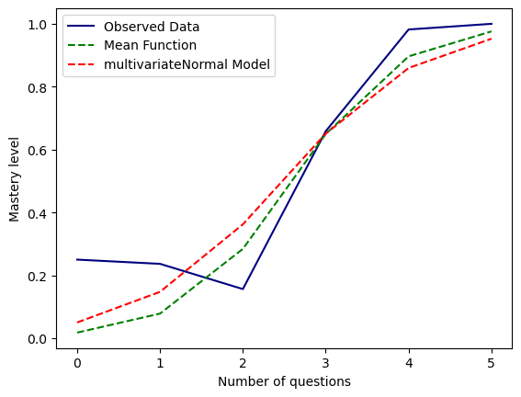
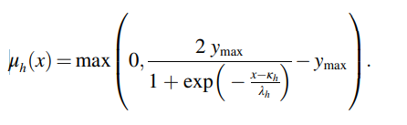
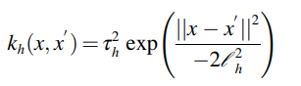
Appendix - Modeling student ability Curve
(Dijkstra et al., 2023)

Slide 26
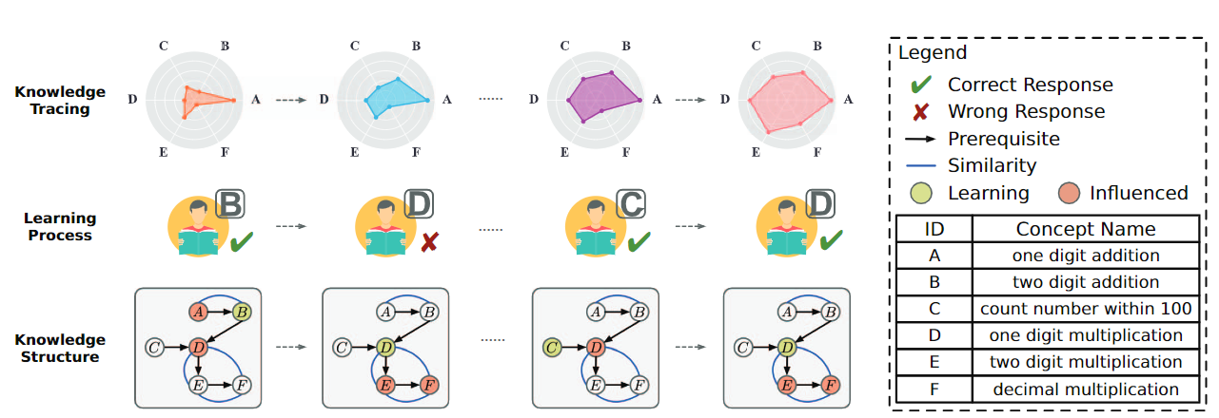
Deep knowledge tracing

Slide 27
Research problem
Introduction to studying adaptive learning system
Set goals for the student’s work session (like a homework assignment) and/or the whole educational context (like a course). This frequently involves an instructor creating a syllabus or assigning some learning objectives.
Deliver assessment questions relevant to those goals.
Estimate the student’s knowledge state based on the correctness of their answers, the difficulty of the questions, and/or the alignment of the questions to a knowledge graph of skills, concepts, or learning objectives.
Decide what activity should come next based on the student’s estimated knowledge state—whether that means delivering easier or harder questions, providing an instructional intervention, remediating a gap in prerequisite knowledge, suggesting the student speak to their teacher, or some other activity.
The cycle of steps (two to four) then continues until each student reaches the goals set in step one.

